Slide 1
Basic Concepts of MongoDB and Big Data
(15 hours)
Notes:
Title - The learning outcome
Subtitle - Duration

Slide 2
In this section, we will discuss:
MongoDB Queries, filter and criteria
Managing Multimedia data in database
Fundamental of Big Data
Managing Big Data
Big Data Tools And Technology
Big Data in cloud
Big Data Analytics
Notes:
Mention the parent topics one by one. This particular learning outcome has 4 parent topics.

Slide 3
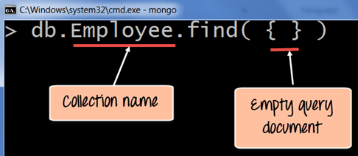
MongoDB queries
What is Queries?
MongoDB Query is a way to get the data from the MongoDB database. MongoDB queries provide the simplicity in process of fetching data from the database, it’s similar to SQL queries in SQL Database language
Image Source: https://www.guru99.com/mongodb-query-document-using-find.html
Notes:
Left (White Color space):
Title - Parent Topic
Subtitle - Subtopic 1
Body Text - Description in bullets
Right (Grey Color Space):
Body Text - Relevant image (with source)/code snippet
Put reference links in Speaker Notes
Reference:
https://www.tutorialspoint.com/internet_technologies/internet_overview.htm/

Slide 4
MongoDB queries
Function Name
MongoDB provides the function names as
db.collection_name.find()
to operate query operation on database.
Image Source: https://www.guru99.com/mongodb-query-document-using-find.html
Notes:
Left (White Color space):
Title - Parent Topic
Subtitle - Subtopic 1
Body Text - Description in bullets
Right (Grey Color Space):
Body Text - Relevant image (with source)/code snippet
Put reference links in Speaker Notes
Reference:
https://www.tutorialspoint.com/internet_technologies/internet_overview.htm/

Slide 5
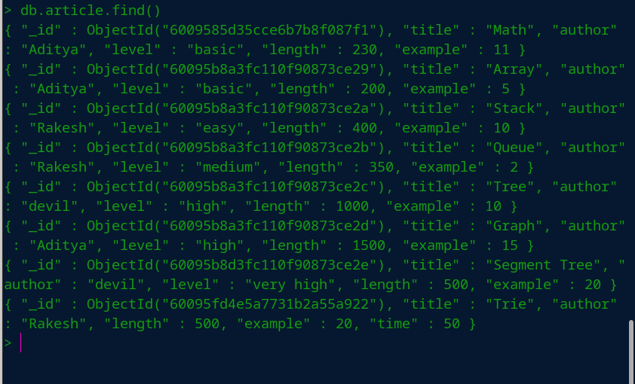
MongoDB queries
MongoDB Query Example – 1
Field Selection - find()
The find() method displays the database collection in Non-Structured form({<Key> : <value>}) including auto-created <key> ” id ” by MongoDB and collection data inserted by user or admin.
Syntax: db.collection_name.find()
Image Source: https://www.geeksforgeeks.org/mongodb-an-introduction/
Notes:
Left (White Color space):
Title - Parent Topic
Subtitle - Subtopic 1
Body Text - Description in bullets
Right (Grey Color Space):
Body Text - Relevant image (with source)/code snippet
Put reference links in Speaker Notes
Reference:
https://www.tutorialspoint.com/internet_technologies/internet_overview.htm/

Slide 6
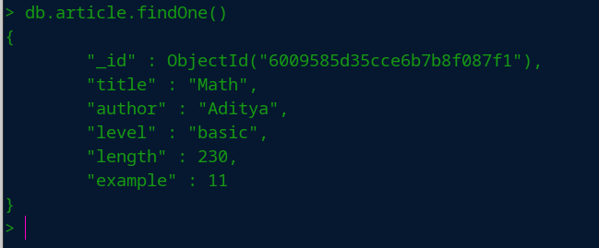
MongoDB queries
MongoDB Query Example – 1
Finding Single Document - findOne()
In MongoDB, we can find a single document using findOne() method, This method returns the first document that matches the given filter query expression.
Syntax: db.collection_name.findOne()
Image Source: https://www.geeksforgeeks.org/mongodb-an-introduction/
Notes:
Left (White Color space):
Title - Parent Topic
Subtitle - Subtopic 1
Body Text - Description in bullets
Right (Grey Color Space):
Body Text - Relevant image (with source)/code snippet
Put reference links in Speaker Notes
Reference:
https://www.tutorialspoint.com/internet_technologies/internet_overview.htm/

Slide 7
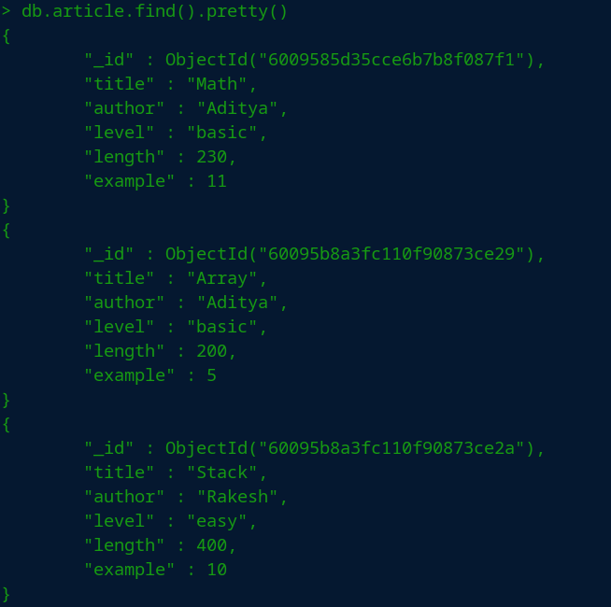
MongoDB queries
Displaying Document in format
pretty() Method
In MongoDB, we can display documents of the specified collection in well-formatted way using pretty() method.
Syntax: db.collection_name.find().pretty()
Image Source: https://www.geeksforgeeks.org/mongodb-an-introduction/
Notes:
Left (White Color space):
Title - Parent Topic
Subtitle - Subtopic 1
Body Text - Description in bullets
Right (Grey Color Space):
Body Text - Relevant image (with source)/code snippet
Put reference links in Speaker Notes
Reference:
https://www.tutorialspoint.com/internet_technologies/internet_overview.htm/

Slide 8
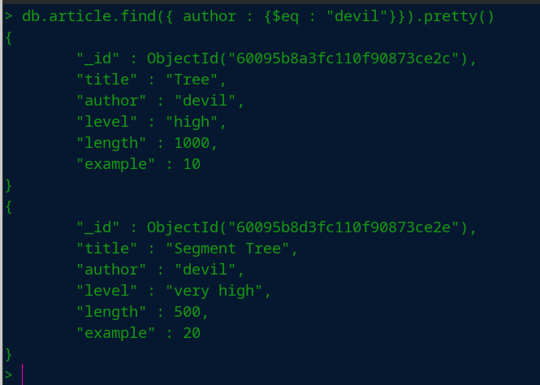
MongoDB Filter queries
Equal Filter Query
$eq
The equality operator($eq) is used to match the documents where the value of the field is equal to the specified value. In other words, the $eq operator is used to specify the equality condition.
Syntax: db.collection_name.find({< key > : {$eq : < value >}})
Image Source: https://www.geeksforgeeks.org/mongodb-an-introduction/
Notes:
Left (White Color space):
Title - Parent Topic
Subtitle - Subtopic 1
Body Text - Description in bullets
Right (Grey Color Space):
Body Text - Relevant image (with source)/code snippet
Put reference links in Speaker Notes
Reference:
https://www.tutorialspoint.com/internet_technologies/internet_overview.htm/

Slide 9
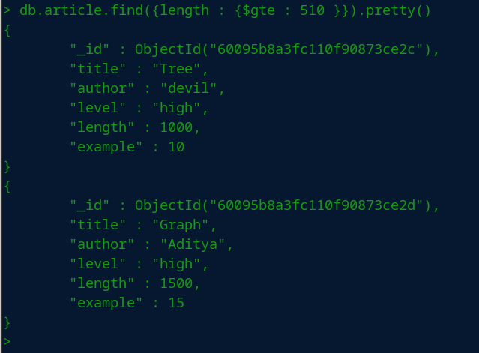
MongoDB Filter queries
Greater Than Filter Query
$gte or $lte
To get the specific numeric data using conditions like greater than equal or less than equal use the $gte or $lte operator in the find() method.
Syntax: db.collection_name.find({< key > : {$gte : < value >}})
OR
db.collection_name.find({< key > : {$lte : < value >}})
Image Source: https://www.geeksforgeeks.org/mongodb-an-introduction/
Notes:
Left (White Color space):
Title - Parent Topic
Subtitle - Subtopic 1
Body Text - Description in bullets
Right (Grey Color Space):
Body Text - Relevant image (with source)/code snippet
Put reference links in Speaker Notes
Reference:
https://www.tutorialspoint.com/internet_technologies/internet_overview.htm/

Slide 10
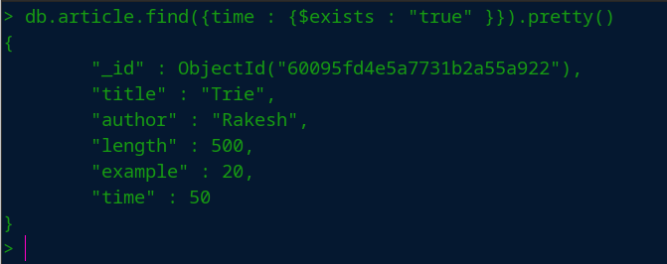
MongoDB Filter queries
Check the existence filter query
$exists
$exists operator shows all the collection documents if they exist on a given key.
Syntax: db.collection_name.find({< key > : {$exists : < boolean >}})
Image Source: https://www.geeksforgeeks.org/mongodb-an-introduction/
Notes:
Left (White Color space):
Title - Parent Topic
Subtitle - Subtopic 1
Body Text - Description in bullets
Right (Grey Color Space):
Body Text - Relevant image (with source)/code snippet
Put reference links in Speaker Notes
Reference:
https://www.tutorialspoint.com/internet_technologies/internet_overview.htm/

Slide 11
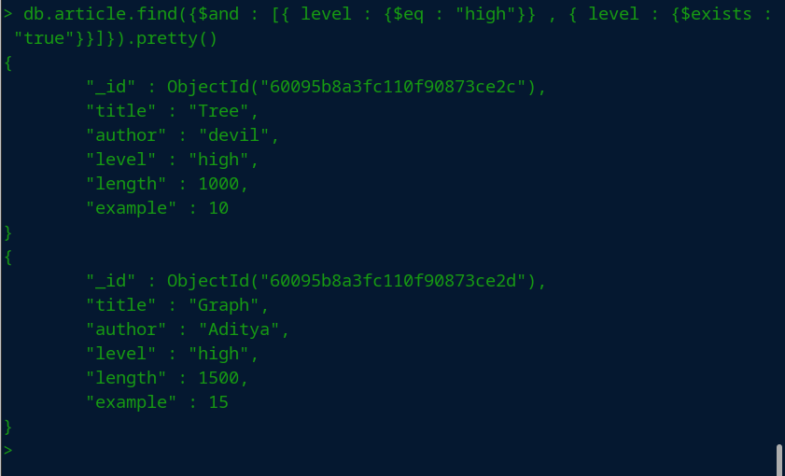
MongoDB Filter queries
Logical Operator Query
$and
$and operator comes under the type of MongoDB logical operator which perform logical AND operation on the array of one or more expressions and select or retrieve only those documents that match all the given expression in the array.
Syntax: db.collection_name.find({$and : [{< key > : {$eq : < value1 >}}, {< key > : {$exists : < boolean >}}]})
Image Source: https://www.geeksforgeeks.org/mongodb-an-introduction/
Notes:
Left (White Color space):
Title - Parent Topic
Subtitle - Subtopic 1
Body Text - Description in bullets
Right (Grey Color Space):
Body Text - Relevant image (with source)/code snippet
Put reference links in Speaker Notes
Reference:
https://www.tutorialspoint.com/internet_technologies/internet_overview.htm/

Slide 12
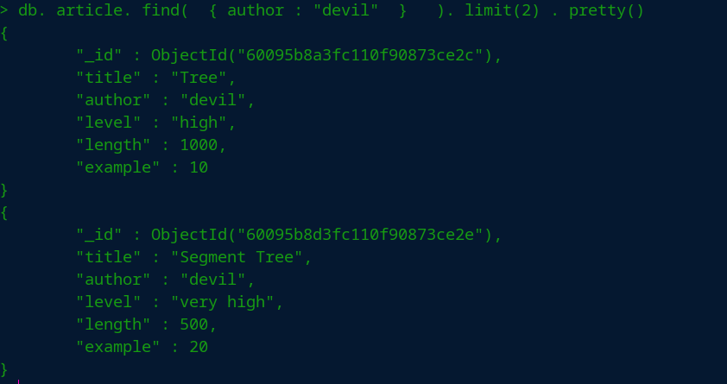
MongoDB limit queries
Limit Query
limit query method specifies a maximum number of documents for a cursor to return.
Syntax :
db.collection_name.find({< key > : < value >}).limit(< Integer_value >)
Image Source: https://www.geeksforgeeks.org/mongodb-an-introduction/
Notes:
Left (White Color space):
Title - Parent Topic
Subtitle - Subtopic 1
Body Text - Description in bullets
Right (Grey Color Space):
Body Text - Relevant image (with source)/code snippet
Put reference links in Speaker Notes
Reference:
https://www.tutorialspoint.com/internet_technologies/internet_overview.htm/

Slide 13

Manage Multimedia Data
Multimedia Data
Multimedia in principle means data of more than one medium. It usually refers to data representing multiple types of medium to capture information and experiences related to objects and events. Commonly used forms of data are numbers, alphanumeric, text, images, audio, and video. In common usage, people refer a data set as multimedia only when time-dependent data such as audio and video are involved.
Image Source: https://mysqlpreacher.com/general-characteristics-common-tools-developing-multimedia-programs/
Notes:
Left (White Color space):
Title - Parent Topic
Subtitle - Subtopic 1
Body Text - Description in bullets
Right (Grey Color Space):
Body Text - Relevant image (with source)/code snippet
Put reference links in Speaker Notes
Reference:
https://www.tutorialspoint.com/internet_technologies/internet_overview.htm/

Slide 14

Manage Multimedia Data
Manage Multimedia Data With GridFS
MongoDB GridFS is used to store and retrieve files that exceeds the BSON document size limit of 16 MB. Instead of storing it all in one document GridFS divides the file into small parts called as chunks.
Image Source: https://javabeat.net/wp-content/uploads/2015/08/gridfs.png
Notes:
Left (White Color space):
Title - Parent Topic
Subtitle - Subtopic 1
Body Text - Description in bullets
Right (Grey Color Space):
Body Text - Relevant image (with source)/code snippet
Put reference links in Speaker Notes
Reference:
https://www.tutorialspoint.com/internet_technologies/internet_overview.htm/

Slide 15
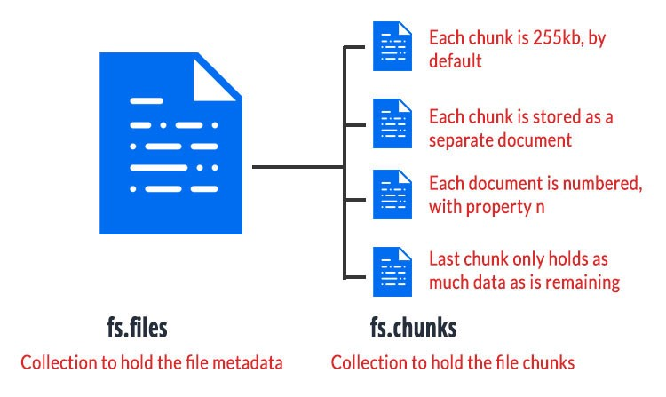
Manage Multimedia Data
When to use GridFS
In MongoDB, use GridFS for storing files larger than 16 MB.
If your filesystem limits the number of files in a directory, you can use GridFS to store as many files as needed.
Image Source: https://medium.com/@kavitanambissan/uploading-and-retrieving-a-file-from-gridfs-using-multer-958dfc9255e8
Notes:
Left (White Color space):
Title - Parent Topic
Subtitle - Subtopic 1
Body Text - Description in bullets
Right (Grey Color Space):
Body Text - Relevant image (with source)/code snippet
Put reference links in Speaker Notes
Reference:
https://www.tutorialspoint.com/internet_technologies/internet_overview.htm/

Slide 16
Manage Multimedia Data
GridFS Collection
GridFS Stores files in two Collections:
Chunks Store Binary Chunks
Files Stores the File’s metadata
GridFS places the collections in a common bucket by prefixing each with the bucket name. By default, GridFS uses two collections with a bucket named fs:
fs.files
fs.chunks
Image Source: https://medium.com/@kavitanambissan/uploading-and-retrieving-a-file-from-gridfs-using-multer-958dfc9255e8
Notes:
Left (White Color space):
Title - Parent Topic
Subtitle - Subtopic 1
Body Text - Description in bullets
Right (Grey Color Space):
Body Text - Relevant image (with source)/code snippet
Put reference links in Speaker Notes
Reference:
https://www.tutorialspoint.com/internet_technologies/internet_overview.htm/

Slide 17
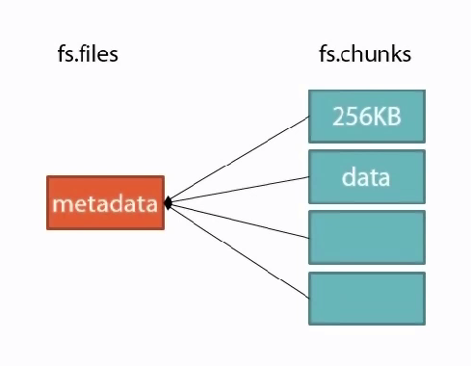
Manage Multimedia Data
The Chunks Collection
Each document in the chunks collection represents a distinct chunk of a file as represented in GridFS. Documents in this collection have the following form:
{
“_id” : <ObjectId>,
“files_id” : <ObjectId>,
“n” : <num>,
“data: : <binary>
}
Image Source: https://nitinasp.wordpress.com/2014/04/29/gridfs-in-mongodb/
Notes:
Left (White Color space):
Title - Parent Topic
Subtitle - Subtopic 1
Body Text - Description in bullets
Right (Grey Color Space):
Body Text - Relevant image (with source)/code snippet
Put reference links in Speaker Notes
Reference:
https://www.tutorialspoint.com/internet_technologies/internet_overview.htm/

Slide 18
Manage Multimedia Data
{
"_id" : <ObjectId>,
"files_id" : <ObjectId>,
"n" : <num>,
"data" : <binary>
}
The Chunks Collection
chunks.id
chunks.files_id
chunks.n
chunks.data
Notes:
Left (White Color space):
Title - Parent Topic
Subtitle - Subtopic 1
Body Text - Description in bullets
Right (Grey Color Space):
Body Text - Relevant image (with source)/code snippet
Put reference links in Speaker Notes
Reference:
https://www.tutorialspoint.com/internet_technologies/internet_overview.htm/

Slide 19
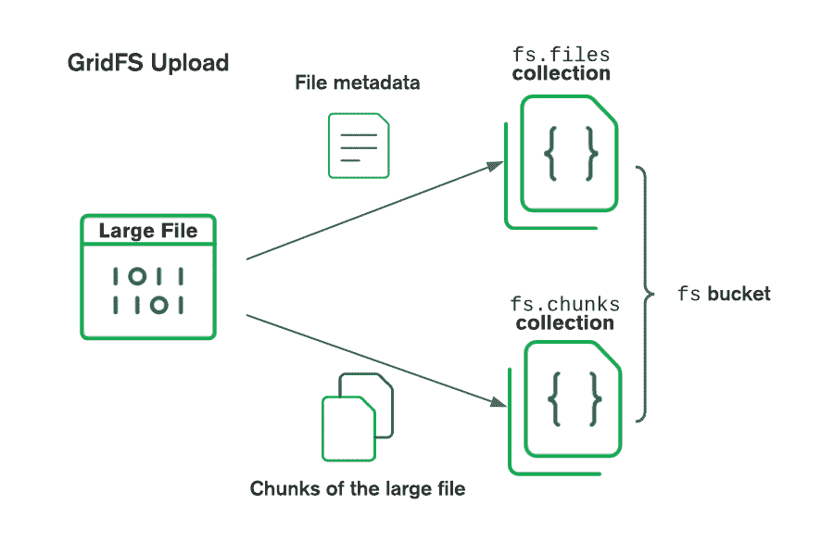
Manage Multimedia Data
The Files Collection
Each document in the files collection represents
a file in GridFS.
files_Id
files.length
files.chunkSize
files.uploadDate
files.md5
files.filename
files.contentType
files.aliases
files.metadata
https://docs.mongodb.com/drivers/node/current/fundamentals/gridfs/
Notes:
Left (White Color space):
Title - Parent Topic
Subtitle - Subtopic 1
Body Text - Description in bullets
Right (Grey Color Space):
Body Text - Relevant image (with source)/code snippet
Put reference links in Speaker Notes
Reference:
https://www.tutorialspoint.com/internet_technologies/internet_overview.htm/

Slide 20
Manage Multimedia Data
Chunk index
Files index
GridFS uses unique, compound index on the chunks collection using the field_id and n Fields.
GridFS uses an index on the files collection using the filename and uploadDate fields
GridFS indexex
GridFS uses indexes on each of the chunks and files collections for efficiency. Drivers that conform to the GridFS specification automatically create these indexes for convenience. You can also create any additional indexes as desired to suit your application's needs.
https://docs.mongodb.com/drivers/node/current/fundamentals/gridfs/
Notes:
Left (White Color space):
Title - Parent Topic
Subtitle - Subtopic 1
Body Text - Description in bullets
Right (Grey Color Space):
Body Text - Relevant image (with source)/code snippet
Put reference links in Speaker Notes
Reference:
https://www.tutorialspoint.com/internet_technologies/internet_overview.htm/

Slide 21
Manage Multimedia Data
Chunk collection
Files collection
To shard the chunks collection, use either { files_id : 1, n : 1 } or { files_id : 1 } as the shard key index.
The files collection is small and only contains metadata
Sharding GridFS
There are two collections to consider with GridFS - files and chunks.
/
Notes:
Left (White Color space):
Title - Parent Topic
Subtitle - Subtopic 1
Body Text - Description in bullets
Right (Grey Color Space):
Body Text - Relevant image (with source)/code snippet
Put reference links in Speaker Notes
Reference:
https://www.tutorialspoint.com/internet_technologies/internet_overview.htm/

Slide 22
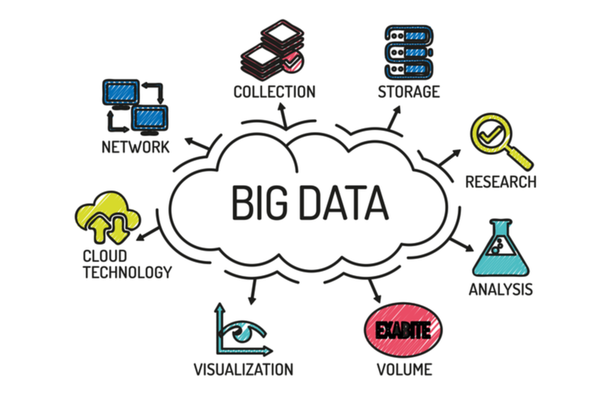
Fundamental of Big Data
Big Data
Big Data is A Collection of large and complex datasets which are difficult to store and process using the traditional database and data processing tools.
Big data is collected from traditional and digital sources which, when refined properly can be used for research and analysis
Image Source : https://bleuwire.com/5-biggest-big-data-challenges/
Notes:
Left (White Color space):
Title - Parent Topic
Subtitle - Subtopic 1
Body Text - Description in bullets
Right (Grey Color Space):
Body Text - Relevant image (with source)/code snippet
Put reference links in Speaker Notes
Reference:
https://www.tutorialspoint.com/internet_technologies/internet_overview.htm/

Slide 23
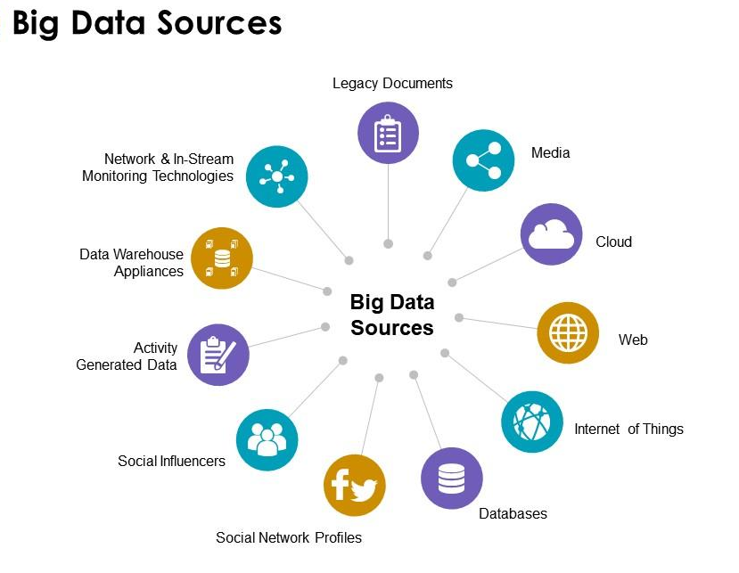
Fundamental of Big Data
Big Data Sources
Social Media
Public Web
Documents
Media
Data Storage
Machine Log data
Sensor Data
IoT
Image Source : https://www.slideteam.net/powerpoint-presentation-slides/strategy-powerpoint-templates-and-presentation-slides/big-data-sources-technologies-ppt-powerpoint-presentation-clipart.html
Notes:
Left (White Color space):
Title - Parent Topic
Subtitle - Subtopic 1
Body Text - Description in bullets
Right (Grey Color Space):
Body Text - Relevant image (with source)/code snippet
Put reference links in Speaker Notes
Reference:
https://www.tutorialspoint.com/internet_technologies/internet_overview.htm/

Slide 24
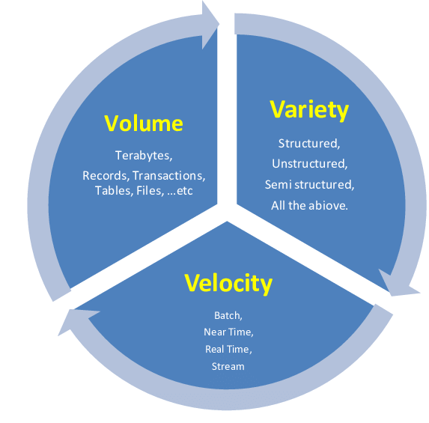
Fundamental of Big Data
3 V’s of Big
Volume
Variety
Velocity
Image Source : https://www.researchgate.net/figure/Big-Data-Definition-3-Vs_fig3_264129835
Notes:
Left (White Color space):
Title - Parent Topic
Subtitle - Subtopic 1
Body Text - Description in bullets
Right (Grey Color Space):
Body Text - Relevant image (with source)/code snippet
Put reference links in Speaker Notes
Reference:
https://www.tutorialspoint.com/internet_technologies/internet_overview.htm/

Slide 25
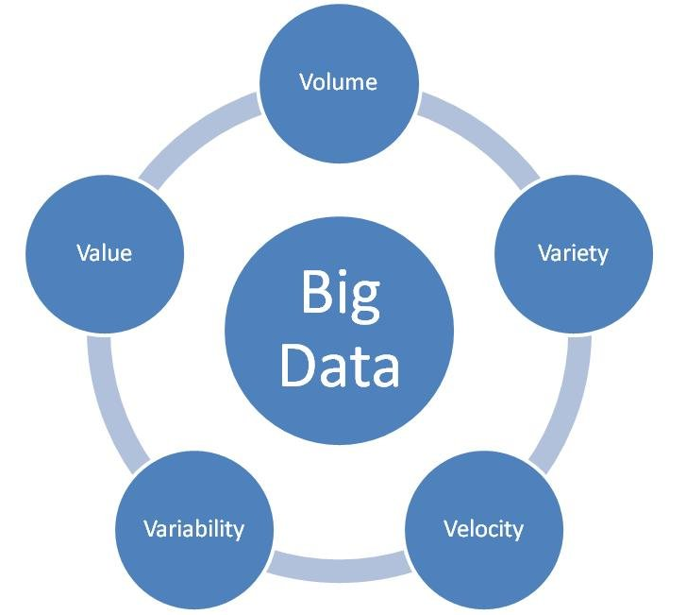
Fundamental of Big Data
5 V’s of Big
Volume
Variety
Velocity
Variability
Value
Image Source : https://www.researchgate.net/figure/Big-Data-Definition-3-Vs_fig3_264129835
Notes:
Left (White Color space):
Title - Parent Topic
Subtitle - Subtopic 1
Body Text - Description in bullets
Right (Grey Color Space):
Body Text - Relevant image (with source)/code snippet
Put reference links in Speaker Notes
Reference:
https://www.tutorialspoint.com/internet_technologies/internet_overview.htm/

Slide 26
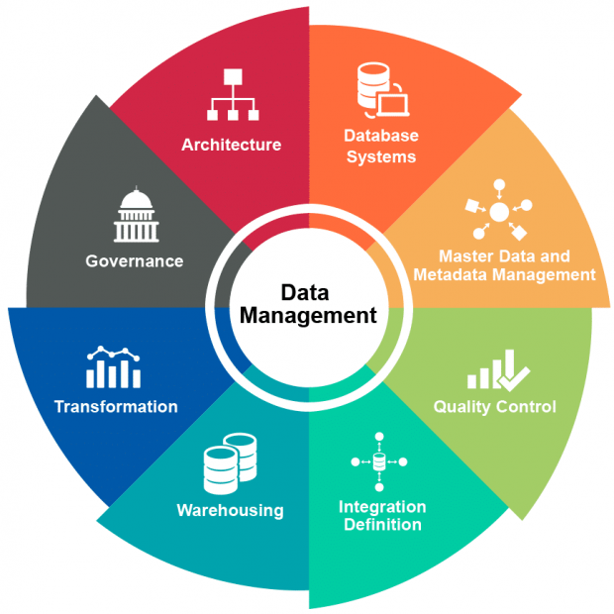
Managing Big Data
Steps For Big Data Management
Determine your Goal
Secure your data
Product the data
Follow Audit regulation
Data need to talk to each other
Need What data to capture
Adapt to changes
Image Source : https://www.researchgate.net/figure/Big-Data-Definition-3-Vs_fig3_264129835
Notes:
Left (White Color space):
Title - Parent Topic
Subtitle - Subtopic 1
Body Text - Description in bullets
Right (Grey Color Space):
Body Text - Relevant image (with source)/code snippet
Put reference links in Speaker Notes
Reference:
https://www.tutorialspoint.com/internet_technologies/internet_overview.htm/

Slide 27
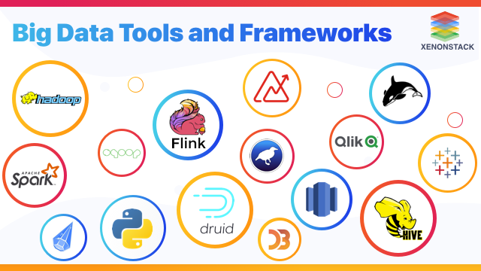
Big Data Tools and Technologies
Big Data Tools
Different tools have been developed by different developers in order to manage huge data. Different tool have its own method of implementation and management. This functionality of tools depends on the aim for which that particular tool was developed
Image Source : https://www.xenonstack.com/blog/big-data-tools
Notes:
Left (White Color space):
Title - Parent Topic
Subtitle - Subtopic 1
Body Text - Description in bullets
Right (Grey Color Space):
Body Text - Relevant image (with source)/code snippet
Put reference links in Speaker Notes
Reference:
https://www.tutorialspoint.com/internet_technologies/internet_overview.htm/

Slide 28

Big Data Tools and Technologies
HDFS – Hadoop Distributed File System
Hadoop Distributed File System (HDFS) distributes the data over the data nodes. There are four types of nodes involved within HDFS. They are:
Name Node
Secondary node
Job Tracker
Slave Nodes
Image Source : https://medium.com/@ujala2yz/sentiment-analysis-on-twitter-data-using-apache-hive-and-mapreduce-2d128ec68fa9
Notes:
Left (White Color space):
Title - Parent Topic
Subtitle - Subtopic 1
Body Text - Description in bullets
Right (Grey Color Space):
Body Text - Relevant image (with source)/code snippet
Put reference links in Speaker Notes
Reference:
https://www.tutorialspoint.com/internet_technologies/internet_overview.htm/

Slide 29

Big Data Tools and Technologies
MapReduce
MapReduce is the combination of job management and the models used in programming for execution. It basically works on the principle of master-slave model in which one node acts as the master node called as the Job Tracker and the other node as slave node called as the Task Trackers.
Job Tracker
Task Tracker
Image Source : https://www.jigsawacademy.com/wp-content/uploads/2017/02/Untitled-design-2.png
Notes:
Left (White Color space):
Title - Parent Topic
Subtitle - Subtopic 1
Body Text - Description in bullets
Right (Grey Color Space):
Body Text - Relevant image (with source)/code snippet
Put reference links in Speaker Notes
Reference:
https://www.tutorialspoint.com/internet_technologies/internet_overview.htm/

Slide 30

Big Data Tools and Technologies
ZooKeeper
Zookeeper is used to manage the process of naming the objects and then further manages theses objects in the hierarchical manner. Due to synchronisation capability of Zookeeper it is also used to control the shared resources such that no deadlock state is met.
Image Source : https://en.wikipedia.org/wiki/Apache_ZooKeeper
Notes:
Left (White Color space):
Title - Parent Topic
Subtitle - Subtopic 1
Body Text - Description in bullets
Right (Grey Color Space):
Body Text - Relevant image (with source)/code snippet
Put reference links in Speaker Notes
Reference:
https://www.tutorialspoint.com/internet_technologies/internet_overview.htm/

Slide 31

Big Data Tools and Technologies
HBase
HBase is the non-relational data management. It does not support SQL queries. Id divides the huge datasets such that these datasets could be used to acquire the required data. The basic development of HBase was from Google ‘s Big Table
The main advantage HBase is that it acts as an alternative for data storage in MapReduce applications. Because of the columnar orientation and the data organizing capacity of HBase
Image Source : https://aws.amazon.com/big-data/what-is-hbase/
Notes:
Left (White Color space):
Title - Parent Topic
Subtitle - Subtopic 1
Body Text - Description in bullets
Right (Grey Color Space):
Body Text - Relevant image (with source)/code snippet
Put reference links in Speaker Notes
Reference:
https://www.tutorialspoint.com/internet_technologies/internet_overview.htm/

Slide 32

Big Data Tools and Technologies
Hive
Hive enables the data organization in data warehousing. Hive works on the query language called HiveQL which is same the SQL. This system provides the way of loading, extracting and transforming data. It also acts as the native access to MapReduce programmers because the users or developers or programmers can integrate the Map and Reduce Functions to HiveQL queries such that it can programs can be used in Hive also. Thus it reduces the effort of programmers to write program again and again.
Image Source : https://en.wikipedia.org/wiki/Apache_Hive
Notes:
Left (White Color space):
Title - Parent Topic
Subtitle - Subtopic 1
Body Text - Description in bullets
Right (Grey Color Space):
Body Text - Relevant image (with source)/code snippet
Put reference links in Speaker Notes
Reference:
https://www.tutorialspoint.com/internet_technologies/internet_overview.htm/

Slide 33

Big Data in Cloud
Big Data In Cloud
Storing and processing big volumes of data requires scalability, fault tolerance and availability. Cloud computing delivers all these through hardware virtualization. Thus, big data and cloud computing are two compatible concepts as cloud enables big data to be available, scalable and fault tolerant.
Image Source : https://www.whizlabs.com/blog/big-data-and-cloud-computing/
Notes:
Left (White Color space):
Title - Parent Topic
Subtitle - Subtopic 1
Body Text - Description in bullets
Right (Grey Color Space):
Body Text - Relevant image (with source)/code snippet
Put reference links in Speaker Notes
Reference:
https://www.tutorialspoint.com/internet_technologies/internet_overview.htm/

Slide 34
Big Data in Cloud
Big Data and Cloud Computing
Big data deals with massive structured, semi-structured or unstructured data to store and process it for data analysis purpose. There are five aspects of Big Data which are described through 5Vs
Volume – the amount of data
Variety – different types of data
Velocity – data flow rate in the system
Value – the value of data based on the information contained within
Veracity – data confidentiality and availability
Image Source : https://www.whizlabs.com/blog/big-data-and-cloud-computing/
Notes:
Left (White Color space):
Title - Parent Topic
Subtitle - Subtopic 1
Body Text - Description in bullets
Right (Grey Color Space):
Body Text - Relevant image (with source)/code snippet
Put reference links in Speaker Notes
Reference:
https://www.tutorialspoint.com/internet_technologies/internet_overview.htm/

Slide 35
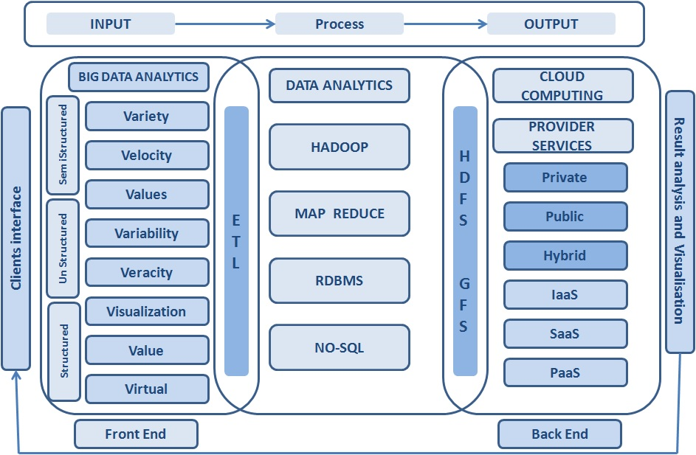
Big Data in Cloud
Big Data and Cloud Computing
IaaS – Infrastructure As a service
PaaS – Platform as A Service
SaaS – System As A Service
Image Source : https://www.whizlabs.com/blog/big-data-and-cloud-computing/
Notes:
Left (White Color space):
Title - Parent Topic
Subtitle - Subtopic 1
Body Text - Description in bullets
Right (Grey Color Space):
Body Text - Relevant image (with source)/code snippet
Put reference links in Speaker Notes
Reference:
https://www.tutorialspoint.com/internet_technologies/internet_overview.htm/

Slide 36
Big Data in Cloud
Cloud Computing Role for Big Data
Big data and Cloud computing relationship can be categorized based on service types:
IAAS in Public Cloud
PAAS in Private Cloud
SAAS in Hybrid Cloud
Image Source : https://www.whizlabs.com/blog/big-data-and-cloud-computing/
Notes:
Left (White Color space):
Title - Parent Topic
Subtitle - Subtopic 1
Body Text - Description in bullets
Right (Grey Color Space):
Body Text - Relevant image (with source)/code snippet
Put reference links in Speaker Notes
Reference:
https://www.tutorialspoint.com/internet_technologies/internet_overview.htm/

Slide 37
Big Data in Cloud
Benefits of Big Data In Cloud
There are multiple benefits of Big data analysis in Cloud.
Improved Analysis
Simplified Infrastructure
Lowering the cost
Security and Privacy
Virtualization
Image Source : https://www.whizlabs.com/blog/big-data-and-cloud-computing/
Notes:
Left (White Color space):
Title - Parent Topic
Subtitle - Subtopic 1
Body Text - Description in bullets
Right (Grey Color Space):
Body Text - Relevant image (with source)/code snippet
Put reference links in Speaker Notes
Reference:
https://www.tutorialspoint.com/internet_technologies/internet_overview.htm/

Slide 38
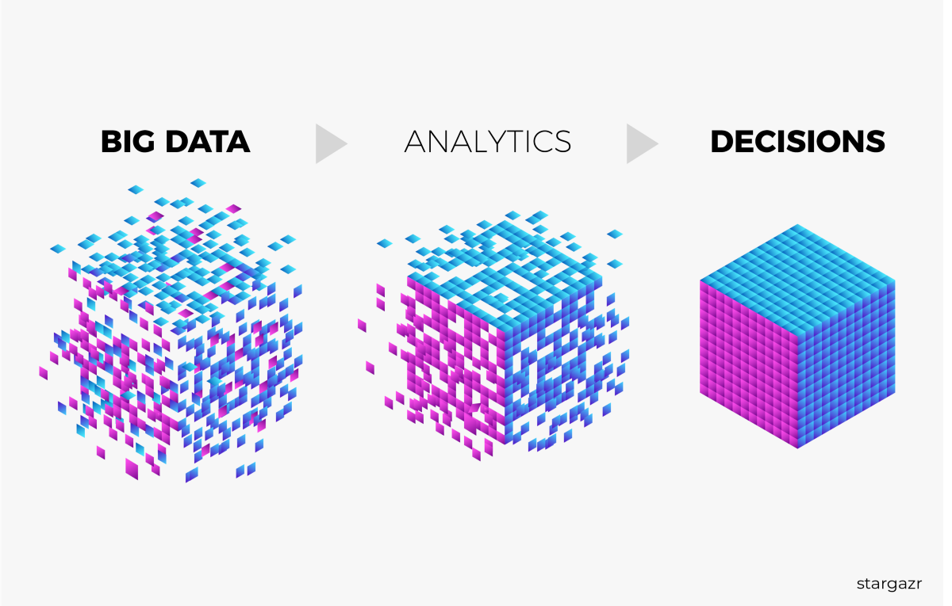
Big Data Analytics
Big Data Analytics
Big Data analytics is the process of collecting, organizing, and analyzing a large amount of data to uncover hidden patterns, correlations, and other meaningful insights. It helps an organization to understand the information contained in their data and use it to provide new opportunities to improve their business which in turn leads to more efficient operations, higher profits, and happier customers.
Image Source :https://miro.medium.com/max/1200/1*eyEB3GZuib_yE_2_80vhtw.png
Notes:
Left (White Color space):
Title - Parent Topic
Subtitle - Subtopic 1
Body Text - Description in bullets
Right (Grey Color Space):
Body Text - Relevant image (with source)/code snippet
Put reference links in Speaker Notes
Reference:
https://www.tutorialspoint.com/internet_technologies/internet_overview.htm/

Slide 39
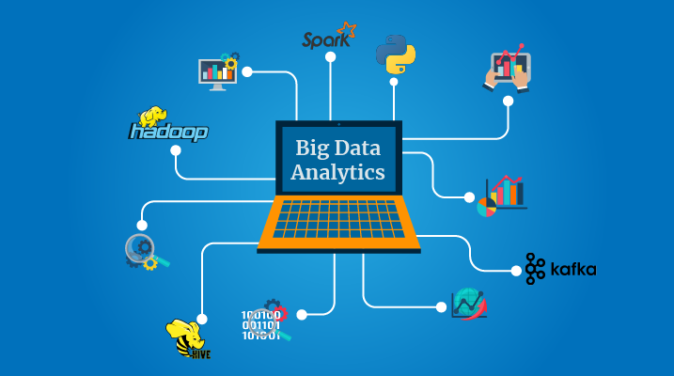
Big Data Analytics
Key Technologies Behind Big Data Analytics
Hadoop
Data Mining
Text Mining
Predictive Analytics
Image Source :https://locusit.com/courses/big-data-analytics-training/
Notes:
Left (White Color space):
Title - Parent Topic
Subtitle - Subtopic 1
Body Text - Description in bullets
Right (Grey Color Space):
Body Text - Relevant image (with source)/code snippet
Put reference links in Speaker Notes
Reference:
https://www.tutorialspoint.com/internet_technologies/internet_overview.htm/

Slide 40
Big Data Analytics
Benefits of Big Data Analytics
Big Data Analytics has been popular among various organizations. Organizations like the e-commerce industry, social media, healthcare, Banking, Entertainment industries, etc., are widely using analytics to understand various patterns, collecting and utilizing customer insights, fraud detection, monitor financial market activities, etc.
Image Source :https://locusit.com/courses/big-data-analytics-training/
Notes:
Left (White Color space):
Title - Parent Topic
Subtitle - Subtopic 1
Body Text - Description in bullets
Right (Grey Color Space):
Body Text - Relevant image (with source)/code snippet
Put reference links in Speaker Notes
Reference:
https://www.tutorialspoint.com/internet_technologies/internet_overview.htm/

